Slide 1


Computational Intelligence (TC2027)

Slide 2
Cyber Resilience Engineering
General Concepts of Cyber Resilience
MITRE Cyber Resiliency Engineering Framework

Slide 3

General Concepts of Cyber Resilience

Slide 4
What is Cyber Resilience?
“Cyber resilience refers to an entity's ability to continuously deliver the intended outcome, despite adverse cyber events.”.
Björck, Fredrik; Henkel, Martin; Stirna, Janis; Zdravkovic, Jelena (2015). Cyber Resilience - Fundamentals for a Definition. Advances in Intelligent Systems and Computing. 353. Stockholm University. pp. 311–316. doi:10.1007/978-3-319-16486-1_31.
“Resilience is the ability to provide and maintain an acceptable level of service in the face of faults and challenges to normal operation.”.
University of Kansas ResiliNets Wiki, https://resilinets.org/ (accessed on 26 Dec 2020).
The ability of a nation, organization, or mission or business process to anticipate, withstand, recover from, and evolve to improve capabilities in the face of, adverse conditions, stresses, or attacks on the supporting cyber resources it needs to function.
BODEAU, Deborah J.; GRAUBART, Richard. Cyber resiliency engineering framework. MITRE CORP BEDFORD MA BEDFORD United States, 2011.

Slide 5
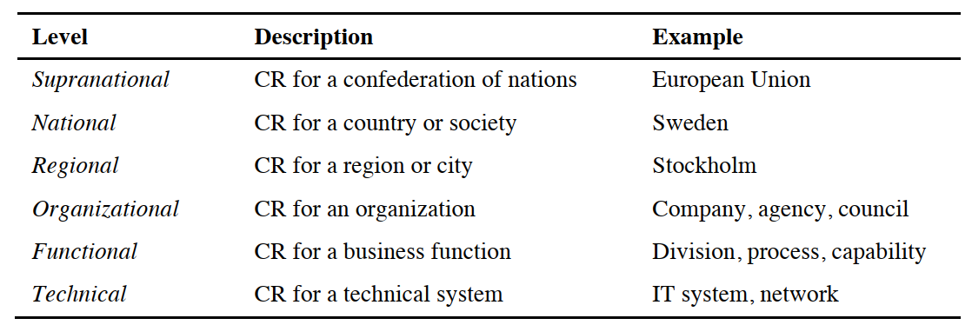
Cyber Resilience Levels
Björck, Fredrik; Henkel, Martin; Stirna, Janis; Zdravkovic, Jelena (2015). Cyber Resilience - Fundamentals for a Definition. Advances in Intelligent Systems and Computing. 353. Stockholm University. pp. 311–316. doi:10.1007/978-3-319-16486-1_31.

Slide 6
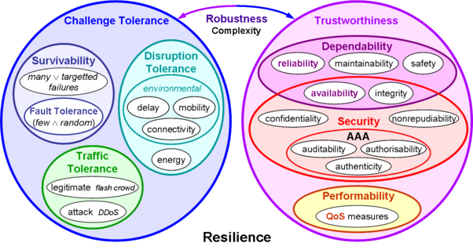
Cyber Resilience Techniques
University of Kansas ResiliNets Wiki, https://resilinets.org/ (accessed on 26 Dec 2020).

Slide 7
Cyber Resilience Techniques
Proactive techniques: architectural or inherent and exist prior to attack.
Reactive techniques: invoked in response to an attack.
GOLDMAN, Harriet; MCQUAID, Rosalie; PICCIOTTO, Jeffrey. Cyber resilience for mission assurance. In: 2011 IEEE International Conference on Technologies for Homeland Security (HST). IEEE, 2011. p. 236-241.

Slide 8
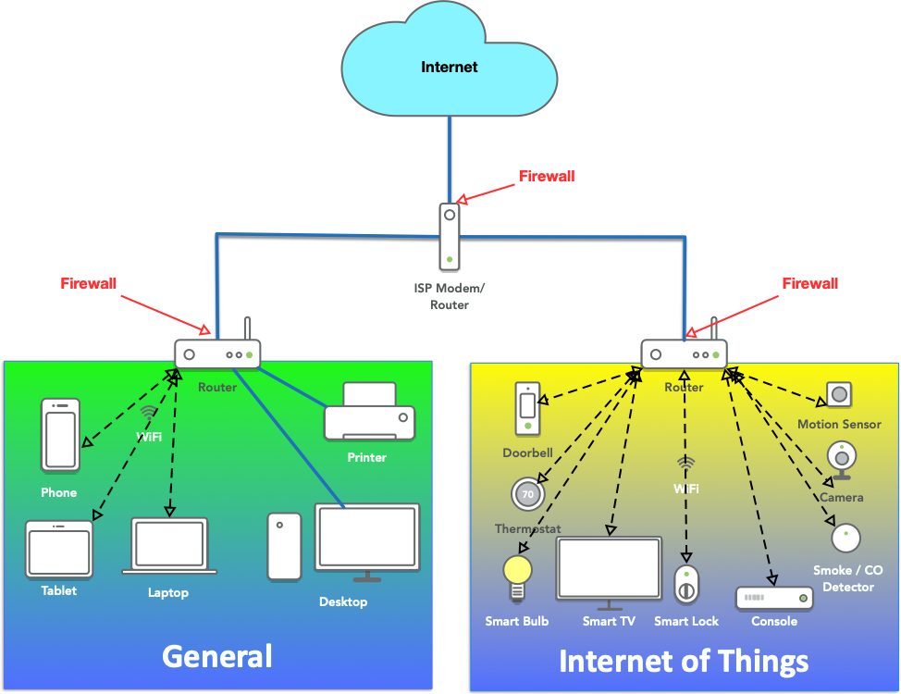
Proactive Techniques
Segmentation, Isolation, Containment: require modifying the system architecture, e.g., by partitioning off components of dubious pedigree from those trusted to reduce the attack surface and limit the damage of exploits when they occur.
Example: Network Segmentation

Slide 9
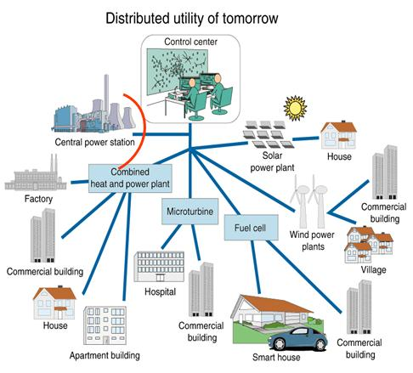
Proactive Techniques
Moving Target and distributedness: When critical processing is distributed, the attacker must know all the locations and attack them all to deny the service or corrupt the capability.

Slide 10
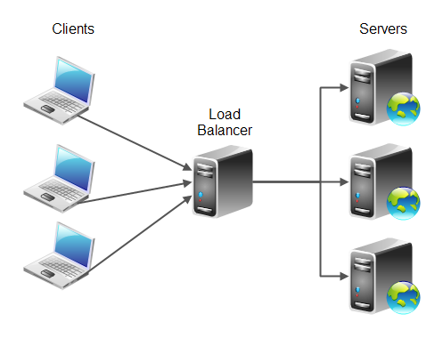



Proactive Techniques
Diversity & Randomness: Confusing an attacker or adding the element of surprise may foil an exploit, introduce uncertainty into the results, put the attacker at risk of being detected or exposing tradecraft, or buy defenders time when systems are under attack (ex.: multiple operating systems, network protocols, etc.).

Slide 11
Proactive Techniques
Non-persistence: can be applied for access to data, applications, and connectivity when continuous access is nonessential. For example, if critical data or applications are only needed during a particular time, they can be made inaccessible at other times.

Slide 12
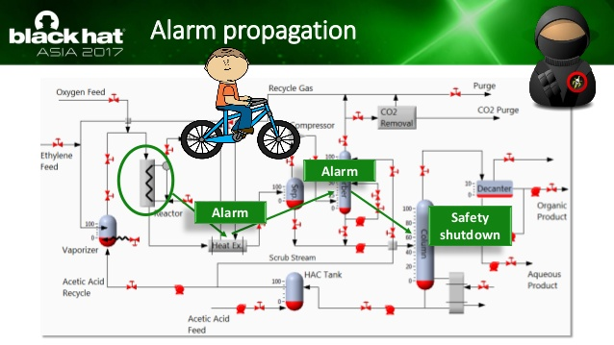
Proactive Techniques
Data and System Integrity & Availability: integrity attacks cause unauthorized resource modification. If the integrity of a component or system is compromised, traditional resilience techniques may worsen the situation. For instance, failover, replication, or reconstitution services that simply move an execution environment or data store to another location can exacerbate the problem by propagating corrupted services or data.

Slide 13
Proactive Techniques
Data and System Integrity & Availability:
Traditional integrity mechanisms such as encrypted checksums, digital signatures, or hashes, integrity can be assured by measuring critical system components.
Use of trusted platform modules (TPMs), anti-tamper mechanisms, or introducing a voting mechanism on systems that have redundant processing or have data residing on distributed nodes.

Slide 14
Reactive Techniques
Dynamic reconfiguration: For example, during a denial-of-service attack, the best initial strategy might be to dynamically over provision additional processing capabilities.
Alternatively, reconfiguring existing capabilities to a more trusted minimal state with a stricter security policy may be more viable.

Slide 15
Reactive Techniques
Dynamic Reconstitution: The high-performance computing and fault tolerant computing communities have established strong technical foundations for reconstitution. These should be applied to mission critical assets.
Dynamic Composition: Under some conditions, new capabilities can be dynamically composed on demand.

Slide 16
Reactive Techniques
Alternative Operations: The core principle underlying alternative operations is to transition mission critical functions to a disjoint architecture to enable continuity even when under attack. Ex.: simplistic as migrating to chat from email; using mobile computing devices in place of centralized servers; or changing application implementations (e.g., switching browsers between Firefox and Explorer).

Slide 17
Reactive Techniques
Deception: is a cybersecurity defense practice that aims to deceive attackers by distributing a collection of traps and decoys across a system's infrastructure to imitate genuine assets.

Slide 18
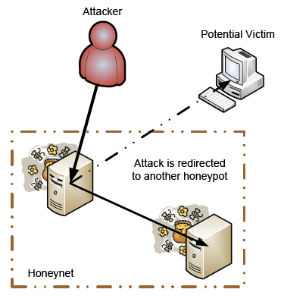
Reactive Techniques
Deception Techniques – Honeypot consists of data (for example, in a network site) that appears to be a legitimate part of the site that seems to contain information or a resource of value to attackers but is isolated and monitored and enables blocking or analyzing the attackers.

Slide 19
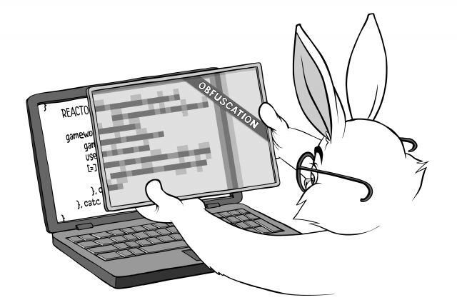
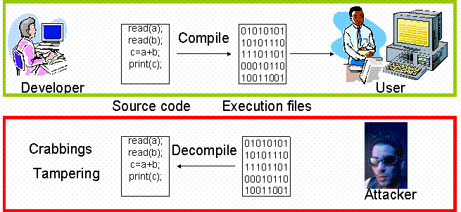
Reactive Techniques
Deception Techniques – Code and data obfuscation involves scrambling objects to retain functionality while making objects look complicated. For example, In software means of the deliberate act of creating source or machine code that is difficult for humans to understand.

Slide 20
Reactive Techniques
Other Deception Techniques:
Cluttering a system can make it difficult to find mission critical components and obfuscates the real targets;
Self‐modifying code;
Self‐protecting data;
Customized and proprietary protocols, extensions, code, solutions, etc.; and
Entrapment techniques; Misinformation.

Slide 21
MITRE Cyber Resiliency Engineering Framework

Slide 22
Cyber Mission Assurance Engineering (MAE)
Mission Assurance Engineering (MAE) extends throughout the entire traditional acquisition life cycle, from concept development through deployment and beyond, to include supply chain considerations and field operations.
It is risk-based, focused on risks to missions due to dependence on cyber resources, and threat-informed, making use of threat information sharing and threat analysis.
Cyber Mission Assurance Engineering: A Risk-Based, Threat-Informed Approach to Address Advanced Adversaries (mitre.org)

Slide 23
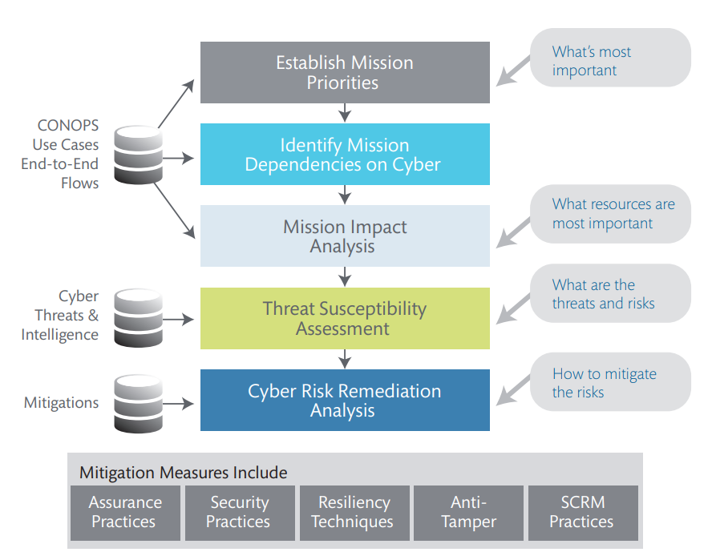
MITRE Cyber MAE Methodology Review
determine which resources are most important, based on their mission criticality and on organizational priorities

Slide 24
MITRE Cyber MAE Methodology Review
Identifies threats, taking into consideration adversary characteristics such as capabilities, intent, and targeting as contributors to the likelihood that an adversary will use a given TTP or set of TTPs, together with information about vulnerabilities or weaknesses in as-built systems or components, in the operational environment, or inherent in information or communications technologies, in order to determine risks.
Notes:
Tactics, Techniques, and Procedures (TTP) describes an approach of analyzing an APT’s operation or can be used as means of profiling a certain threat actor.

Slide 25
MITRE Cyber MAE Methodology Review
Mitigations can be drawn from multiple disciplines, including assurance, security, resiliency, anti-tamper (AT), and
supply chain risk management (SCRM).

Slide 26
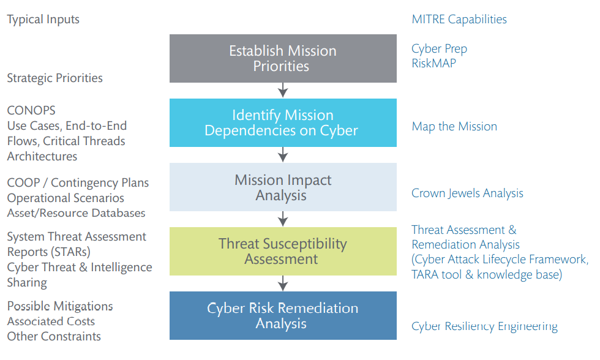
Notes:
RISKMAP - SCHULZ, Alexia E.; KOTSON, Michael C.; ZIPKIN, Joseph R. Cyber network mission dependencies. MASSACHUSETTS INST OF TECH LEXINGTON LINCOLN LAB, 2015.
MUSMAN, Scott; TEMIN, Aaron. A cyber mission impact assessment tool. In: 2015 IEEE International Symposium on Technologies for Homeland Security (HST). IEEE, 2015. p. 1-7.

Slide 27

Cyber Resilience Engineering
Cyber resiliency engineering is the sub-discipline of mission assurance engineering which considers: (i) the ways in which an evolving set of resilience practices can be applied to improve cyber resiliency, and (ii) the trade-offs associated with different strategies for applying those practices.
How can information systems, systems-of-systems, and the mission or business processes they support, be engineered to provide resilience in the presence of advanced cyber threats?

Slide 28
Concepts - Cyber Threats
A clear model of the threat is crucial to defining resilience goals.
Cyber threats are variously characterized – for example, in terms of behavior and in terms of adversary characteristics.
Adversary characteristics can be categorized as capabilities, intent, and targeting.
BODEAU, Deborah J.; GRAUBART, Richard; FABIUS-GREENE, Jennifer. Improving cyber security and mission assurance via cyber preparedness (cyber prep) levels. In: 2010 IEEE Second International Conference on Social Computing. IEEE, 2010. p. 1147-1152.

Slide 29
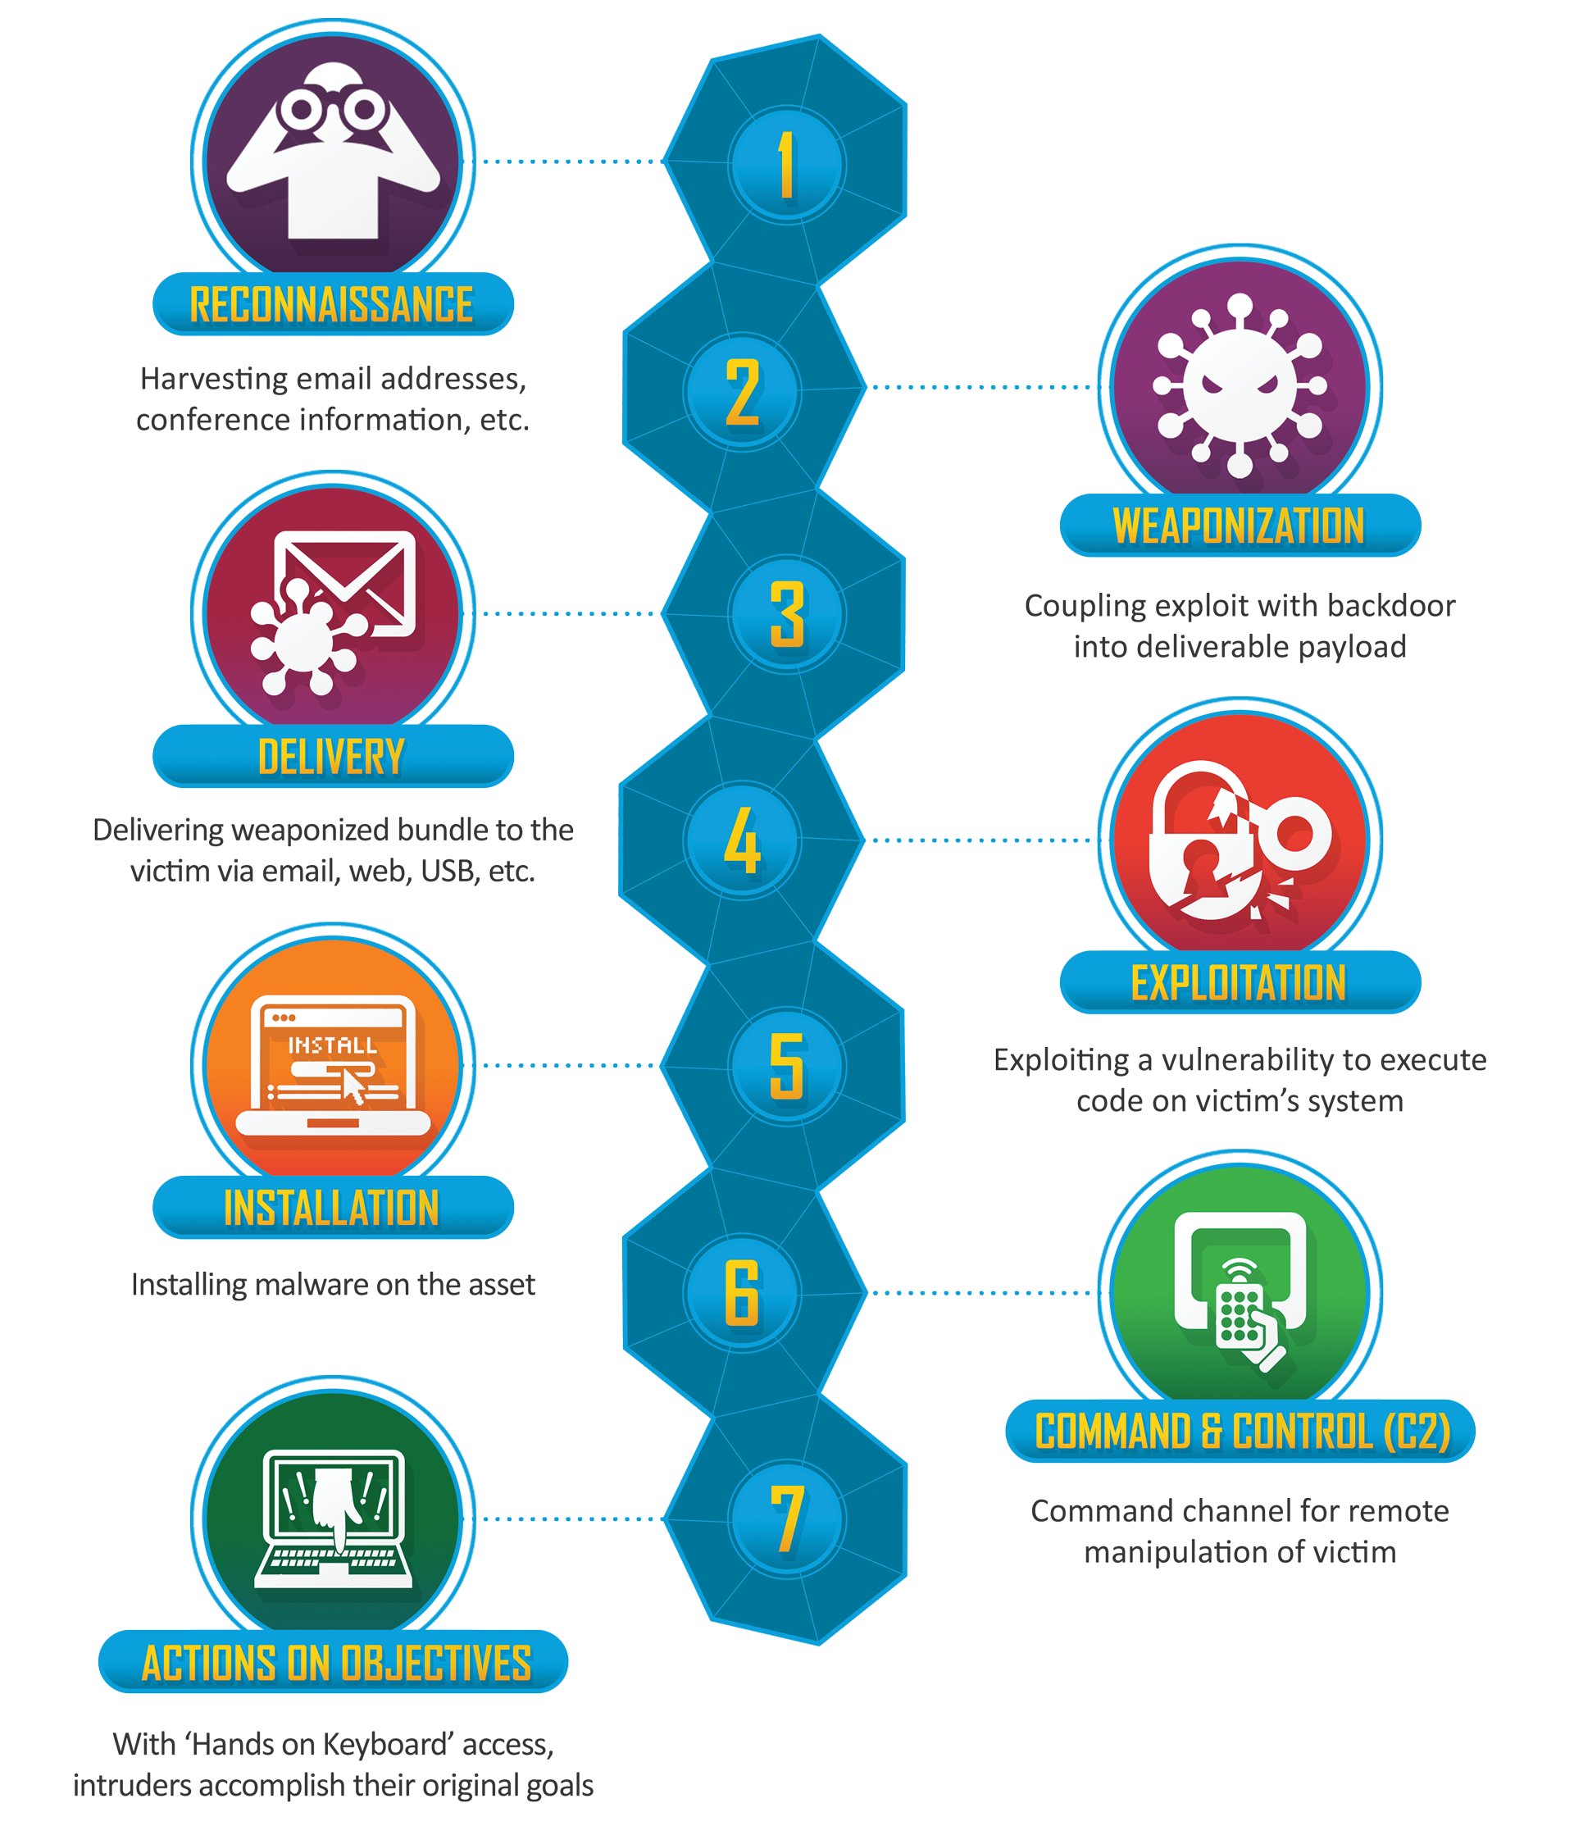
Concepts - Cyber Kill Chain
Cyber kill chain is a way to describe the behavior or activities of a stealthy, persistent adversary who uses malware to gain a foothold into systems and then uses that foothold to achieve objectives.
https://www.lockheedmartin.com/en-us/capabilities/cyber/cyber-kill-chain.html

Slide 30

Concepts - Cyber Resilience
The ability of a nation, organization, or mission or business process to anticipate, withstand, recover from, and evolve to improve capabilities in the face of, adverse conditions, stresses, or attacks on the supporting cyber resources it needs to function.

Slide 31
Concepts - Cyber Resilience
as resiliency of the set of cyber resources on which a mission, business process, or organization depends;
as resiliency of the mission, business process, or organization in the face of cyber threats.
Thus, cyber resiliency has an operational aspect as well as a technical one.

Slide 32
Cyber Resilience Engineering
Cyber resiliency engineering could be characterized as resilience engineering focused on cyber threats.
Cyber resiliency includes not only protecting critical resources from degradation or denial of service prior to or during an attack, but also ensuring their integrity, recovering or reconstructing mission functionality, and evolving to be better prepared for new threats.
Cyber resiliency engineering focuses on applying architectural practices and mechanisms to improve cyber resiliency.

Slide 33
Cyber Resilience Engineering
Cyber resiliency engineering is informed by the organization’s culture, mission priorities and risk tolerance, and risk framing (NIST Cyber Framework).
Cyber resiliency can be viewed as part of cyber security, particularly at the national level, where Cyber security (or cybersecurity) is defined as “the ability to protect or defend the use of cyberspace from cyber attacks”.

Slide 34
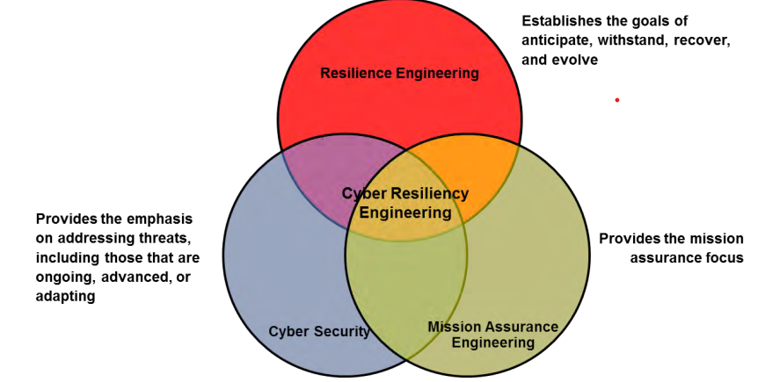
Cyber Resilience Engineering

Slide 35

Core Components of Cyber Resilience Engineering Framework
What are the goals and objectives of cyber resiliency? That is, how can the definition of cyber resiliency be expanded to be useful for investment planning or change management?
What practices (also referred to as techniques, strategies, or approaches) can be applied to meet those goals and objectives?

Slide 36

Core Components of Cyber Resilience Engineering Framework
Threat model: What threats are cyber resiliency practices intended to address?

Slide 37

Core Components of Cyber Resilience Engineering Framework
Applicability domains: Where – to which architectural layers or to which sets of cyber resources – are cyber resiliency practices, measures (controls, mechanisms, procedures), and solutions (specific products or implementations) applied?

Slide 38

Core Components of Cyber Resilience Engineering Framework
Aspects of cost: What types of costs (and non-resiliency-specific benefits) are associated with the use of a cyber resiliency practice, mechanism, or specific product or implementation?

Slide 39

Goals, Objectives & Practices

Slide 40

Core Components of Cyber Resilience Engineering Framework
Aspects of cost: What types of costs (and non-resiliency-specific benefits) are associated with the use of a cyber resiliency practice, mechanism, or specific product or implementation?

Slide 41
Elements of Cyber Resilience
Goals are high-level statements of intended outcomes.
Objectives are more specific statements of intended outcomes, expressed to facilitate assessment; an objective can be identified with a single goal but may support achieving multiple goals.
Practices are ways to achieve one or more cyber resiliency objectives that are applied to the architecture or design of mission/business functions and the cyber resources that support them.

Slide 42
Cyber Resilience Goals
Anticipate: maintain a state of informed preparedness in order to forestall compromises of mission/business functions from adversary attacks.
Withstand: continue essential mission/business functions despite successful execution of an attack by an adversary.
Recover: restore mission/business functions to the maximum extent possible after successful execution of an attack by an adversary.
Evolve: change missions/business functions and/or the supporting cyber capabilities, to minimize adverse impacts from actual or predicted adversary attacks.

Slide 43
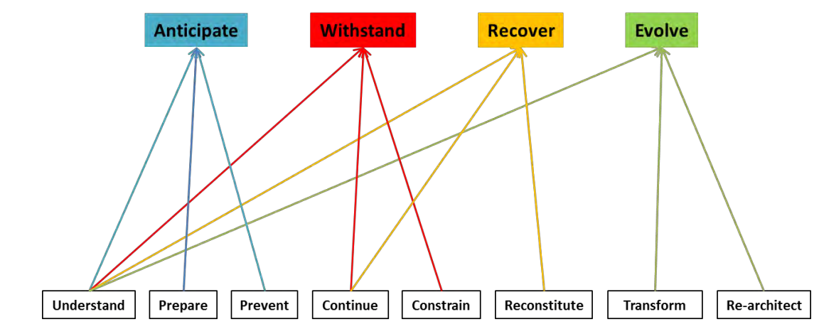
Cyber Resiliency Goals and Objectives

Slide 44
Cyber Resiliency Objectives
Understand is to maintain useful representations of adversaries, mission or business function dependencies on cyber resources, and the status of those resources with respect to adversary activities.
Prepare is to maintain a set of realistic cyber courses of action (CoA) that address predicted cyber attacks.
Prevent is to preclude successful execution of an attack on a set of cyber resources.

Slide 45
Cyber Resiliency Objectives
Continue is to maximize the duration and viability of essential mission/business functions during an attack.
Constrain is to limit damage from an adversary’s attacks.
Reconstitute is to redeploy cyber resources to provide as complete a set of mission/business functionality as possible after a successful attack.

Slide 46
Cyber Resiliency Objectives
Transform is to change aspects of organizational behavior in response to prior, current, or prospective adversary attacks.
Re-architect is to modify architectures to apply cyber resiliency practices more effectively; to address predicted long-term changes in adversary capabilities, intent, and/or targeting; and to incorporate emerging technologies in ways that improve (or at least do not degrade) cyber resiliency.

Slide 47

Cyber Resilience Practices

Slide 48

Adaptive Response involves selecting, executing, and monitoring the effectiveness of the CoA that best changes the attack surface, maintains critical capabilities, and restores functional capabilities.
Select and tailor CoA
Dynamically reconfigure existing resources
Dynamically provision by reallocating existing resources
Dynamically reconstitute critical assets or capabilities
Track effectiveness of CoA and adapt as necessary
Identify and restore non-critical functional capabilities

Slide 49

Analytic Monitoring is to gather and analyze data on an ongoing basis and in a coordinated way to identify potential vulnerabilities, adversary activities, and damage.
Coordinate sensor coverage to avoid gaps or blind spots
Correlate or otherwise combine data from different sensors
Analyze data to identify anomalies, develop I&W, and monitor effectiveness of CoAs
Dynamically reposition or reconfigure sensors
Perform malware and forensic analysis
Perform damage assessment
Perform retrospective analysis to investigate historical trends and activities

Slide 50
Coordinated Defense is to manage adaptively and in a coordinated way multiple, distinct mechanisms to defend critical resources against adversary activities.
Identify key locations to place mechanisms
Provide protection mechanisms at different locations
Identify dependencies and interactions among cyber defenses, security controls, and performance controls
Coordinate ongoing management
Coordinate definition and assignment of privileges
Define / maintain CoAs that can be executed in a coordinated way given existing controls and management responsibilities
Coordinate response activities to ensure synergy rather than interference
Coordinate recovery activities to avoid gaps in security coverage

Slide 51

Deception is to use obfuscation and misdirection (e.g., disinformation) to confuse an adversary.
Conceal mission processing and communications, e.g., function hiding
Transform data for obfuscation
Create and maintain deception environment(s), e.g., honeypots,
honeynets, decoy documents or data stores
Redirect adversary activities to deception environment(s)
Observe and analyze adversary activities in deception environments

Slide 52

Diversity is to use a heterogeneous set of technologies (e.g., hardware, software, firmware, protocols) to minimize the impact of attacks and force adversaries to attack multiple different types of technologies.
Maintain or dynamically create determinably different instantiations / implementations of capabilities or component functionality (e.g., different operating systems, applications, hardware)
Define and maintain determinably different alternative processing paths (i.e., different sequences of services or applications used to respond to the same request)
Define and maintain determinably different alternative communications paths (e.g., different protocols, different communications media)
Establish means to deploy diverse resources rapidly (e.g., in near real time)
Identify and maintain determinably different mission data sources

Slide 53

Dynamic Positioning is to use distributed processing and dynamic relocation of critical assets and sensors.
Use distributed processing and virtualization to relocate targeted resources
Dynamically relocate critical assets
Dynamically relocate sensors

Slide 54

Dynamic Representation is to construct and maintain dynamic representations of components, systems, services, mission dependencies, adversary activities, and effects of alternative cyber courses of action. A representation is dynamic if it can reflect changes in state or behavior.
Define and maintain a representation of the resiliency posture (including security posture, performance with respect to SLAs or KPPs, and quality as determined using Substantiated Integrity mechanisms) of cyber resources and adversary activities against cyber resources
Identify, and maintain a representation of, functional and mission dependencies among cyber resources
Simulate and/or exercise CoAs

Slide 55
Non‐Persistence is to retain information, services, and connectivity for a limited time, thereby reducing an adversary’s opportunity to exploit vulnerabilities and establish a persistent foothold.
Identify services and information to which non-persistence can be applied
Define lifespan conditions for services and connectivity
Terminate services or connectivity when lifespan conditions no longer hold
Define retention conditions for information
Delete or move information when retention conditions no longer hold
Ensure that termination, deletion, or movement does not leave residual data or software behind

Slide 56

Privilege Restriction is to restrict privileges required to use cyber resources, and privileges assigned to users and cyber entities, based on the type(s) and degree(s) of criticality and trust respectively, to minimize the potential consequences of adversary activities.
Determine degrees of criticality of cyber resources, thereby identifying critical assets
Determine types and degrees of trust for users and cyber entities (e.g., components, data, processes, interfaces)
Assign privileges based on types and degrees of trust
Assign and maintain privilege restrictions, particularly for critical assets
Increase or decrease privilege restrictions based on adversary activities

Slide 57
Realignment is to align cyber resources with core aspects of mission/business functions, thus reducing the attack surface.
Identify mission / business function dependencies on cyber resources
Identify non-mission / business function dependencies on or uses of cyber resources
Assess mission / business function risks due to dependency on resources shared with non-mission functions
Reallocate resources and/or reassign administrative / management responsibility based on risk to mission / business function
Identify and remove or replace data feeds and connections for which risks outweigh benefits

Slide 58

Redundancy is to maintain multiple protected instances of critical resources (information and services).
Maintain multiple protected instances of hardware
Create and maintain multiple protected instances of software
Create and maintain multiple protected instances of information

Slide 59

Segmentation is to separate (logically or physically) components based on pedigree and/or criticality, to limit the spread of or damage from successful exploits.
Define an enclave or set of cyber resources with a clear boundary
Maintain boundary protections
Isolate the enclave or set of cyber resources to contain adversary activities

Slide 60

Substantiated Integrity is to ascertain that critical services, information stores, information streams, and components have not been corrupted by an adversary.
Validate data provenance
Validate data integrity / quality to ensure it has not been corrupted
Validate software / service integrity / behavior to ensure it has not been corrupted

Slide 61
Unpredictability is to make changes frequently and randomly, not just in response to actions by the adversary.
Define an implementable set of change parameters (e.g., conditions under which unpredictable changes should not be made, “distance” beyond which a service should not be moved, ranges for frequency of changes)
Reconfigure components and services, use alternative equivalent components or services, or dynamically reposition processing randomly, in accordance with change parameters

Slide 62
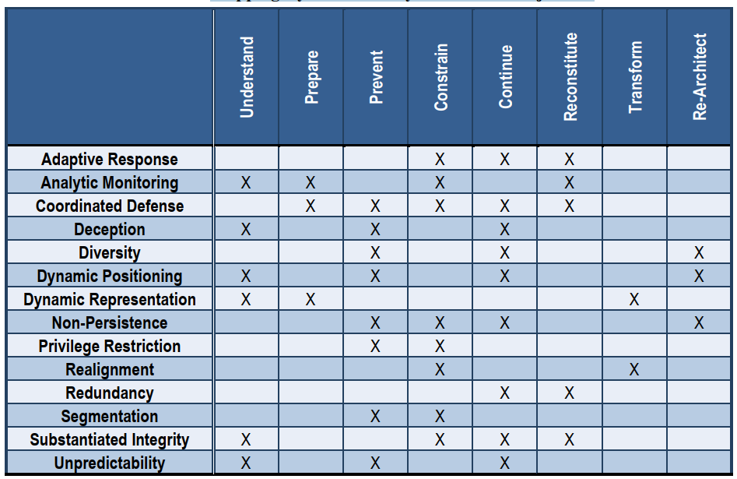
Mapping Cyber Resiliency Practices to Objectives

Slide 63
Threat Model

Slide 64
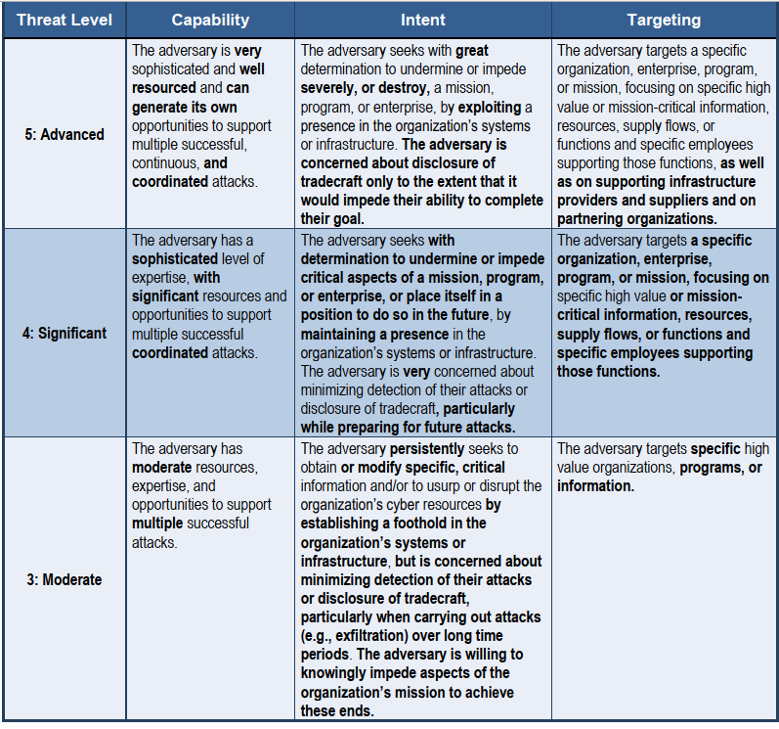

Slide 65
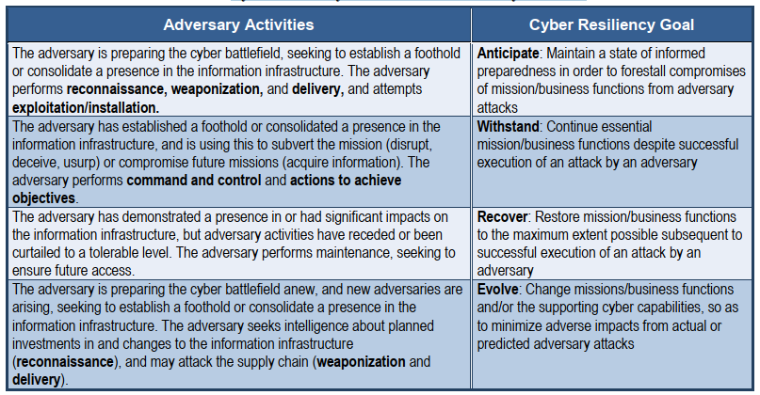
Cyber Resiliency Goals x Adversary Activities

Slide 66
Domains for Applying Cyber Resiliency

Slide 67
Domains
Organization or enterprise (including governance structures and processes)
Mission or line of business (local to an organization, or cross-organizational)
Mission/business process or task (local to an organization, or cross-organizational; when local to an organization, often identified with a business unit or sub-organization)
Mission task or capability support
Cyber resources (e.g., mission/business segments, systems-of-systems, networks, shared services or infrastructure, systems, databases/knowledge bases)
Personnel (individuals who could be tasked with executing a mission function)
Organizational processes and structures
o Facilities

Slide 68
Costs Considerations

Slide 69
Costs
Initial Costs (I): required costs to establish the resiliency techniques/technology that support the resiliency objective(s). Includes the development, acquisition, installation, and integration costs.
Support Costs (S): required costs to maintain and facilitate the effective use of the approach. Support elements include, but are not limited to, CONOPS development, policy development, testing, risk assessment, and training.
Consequential Costs and Benefits (C): The consequences of using the approach can be positive (benefits) or negative (costs) and can apply to all stakeholders or only to selected stakeholders.

Slide 70
Computational Intelligence (TC2027)

